Slide 1
M.J. Murdock Charitable Trust
Essentials of Development
Strategic Planning & Execution!
Dr. David Alexander, President
Alexander Resource Strategies

Slide 2


Slide 3


Slide 4
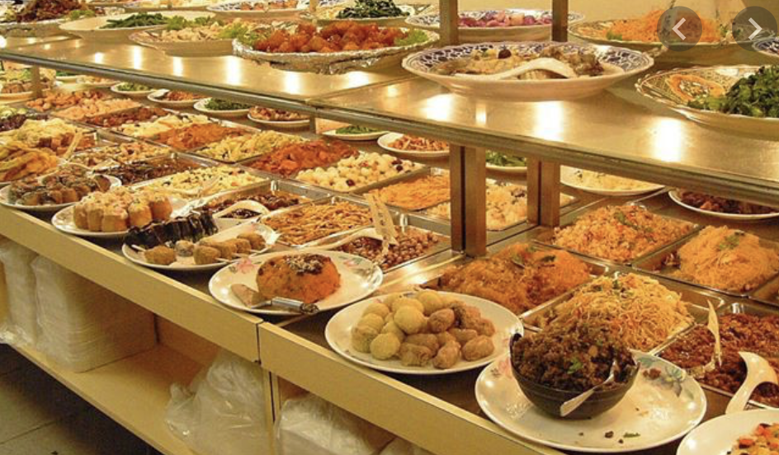

Slide 5
COVID
POP QUIZ

Slide 6
PLANNING & EXECUTION
POP QUIZ

Slide 7

A Story from My House to Yours

Slide 8


Slide 9


Slide 10
What’s the point of the story of my house?
We all make plans.
Not all plans are realized.
We must set aside the time, devote the funds, marshal the energy and do the work for our plans to come to fruition.

Slide 11
A COVID REALITY
YOU ARE WHERE YOU ARE!
It’s not where you will be one year from now.
Let’s make plans to make plans and do the work to be in a better place!

Slide 12
Overview of Session
Essentials of Development
Case Statement
Segmented Donor List
Annual Plan
Development Team
Organizational Essentials—Mission, Vision, Values
Essentials of Long-Range & Short-Range Plans:
Creating a Culture of Planning & Execution

Slide 13
Organizational Essentials
Mission, Vision & Values
Mission, vision and values undergird and guide an organization’s people, programs, operations and service.

Slide 14
ZOOM QUIZ
Mission, Vision, Values

Slide 15
Big Questions – Three Examples
Peter Drucker
What is your mission?
Who is your customer?
What does your customer value?
What are your results?
What is your plan?

Slide 16
Big Questions – Three Examples
John & Miriam Carver
What are the opportunities or needs we exist to address? (Purpose)
What are we doing to address these needs? (Business)
What beliefs or principles guide our work? (Values)
[Bonus Question: Who are your moral owners? Who are your beneficiaries?]

Slide 17
Big Questions – Three Examples
Patrick Lencioni
Why Do We Exist?
How Do We Behave?
What Do We Do?
How Will We Succeed?
What Is Most Important, Right Now?
Who Must Do What?

Slide 18
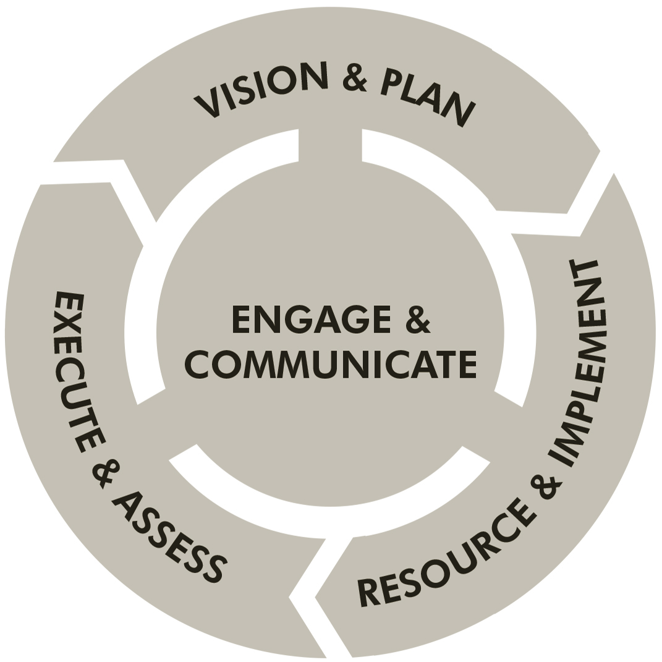
A Culture of
Planning &
Execution

Slide 19
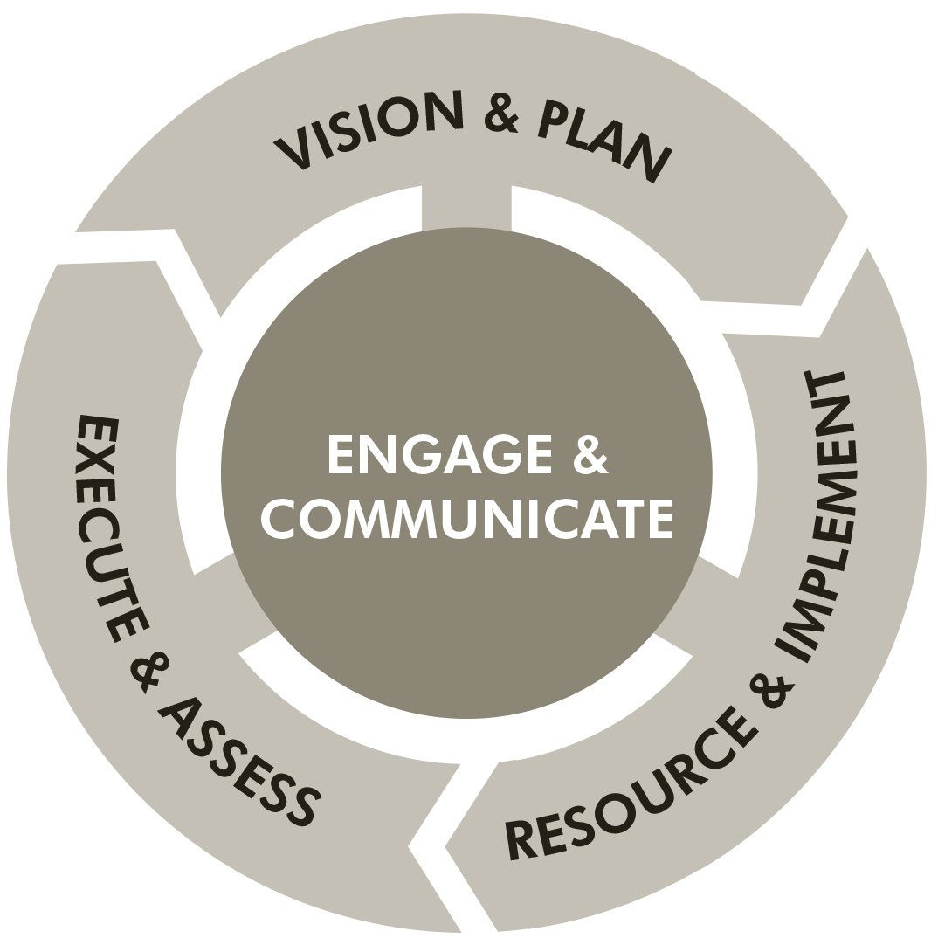
Effective Organizations Engage & Communicate
Vital organizations
foster a culture of
engagement and
communication
centered in the
institution’s mission
and work.

Slide 20
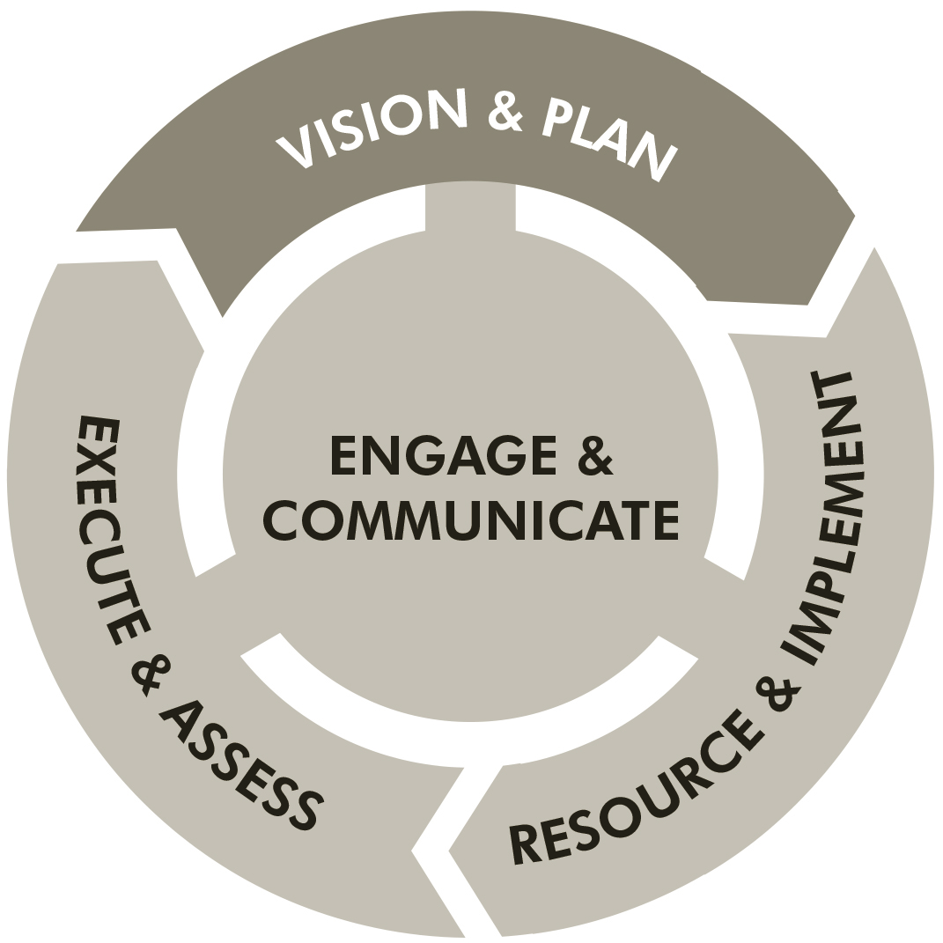
Effective Organizations Vision & Plan
Vital organizations
examine and declare
who they are, whom
they serve, what they
do, where they are
headed and how they
will get there.

Slide 21
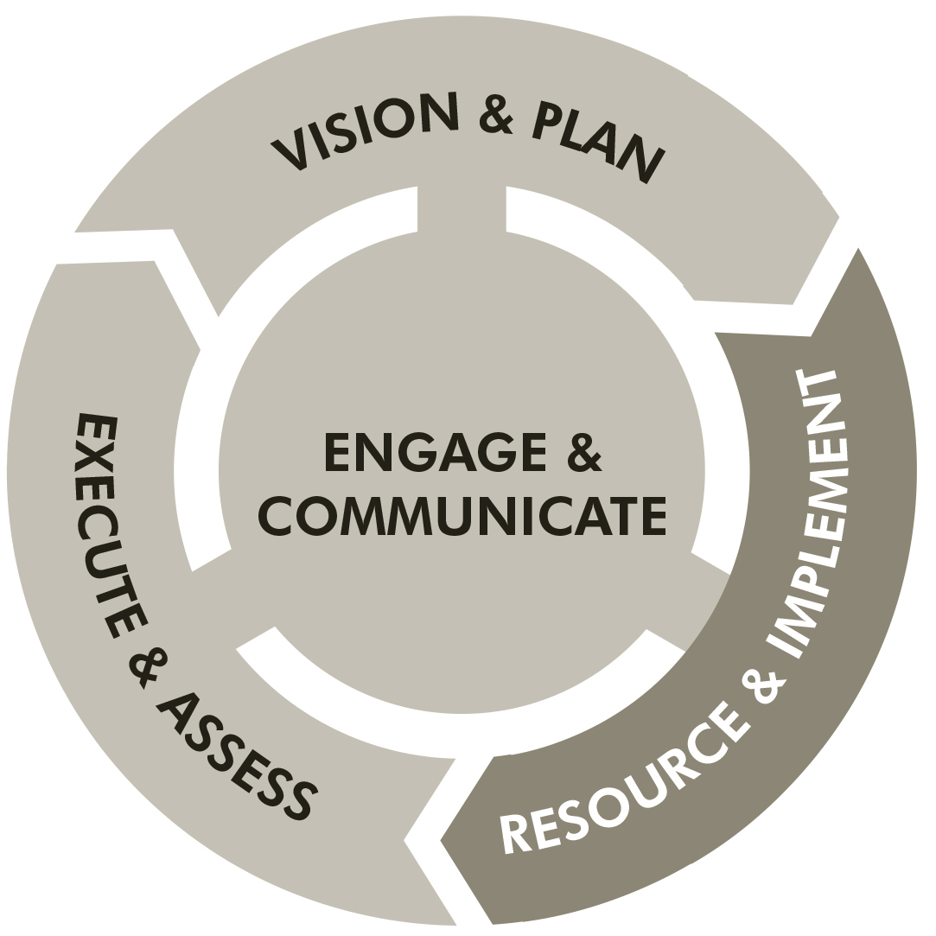
Effective Organizations Resource & Implement
Vital organizations
secure the resources
necessary to
implement plans
that fulfill mission.

Slide 22
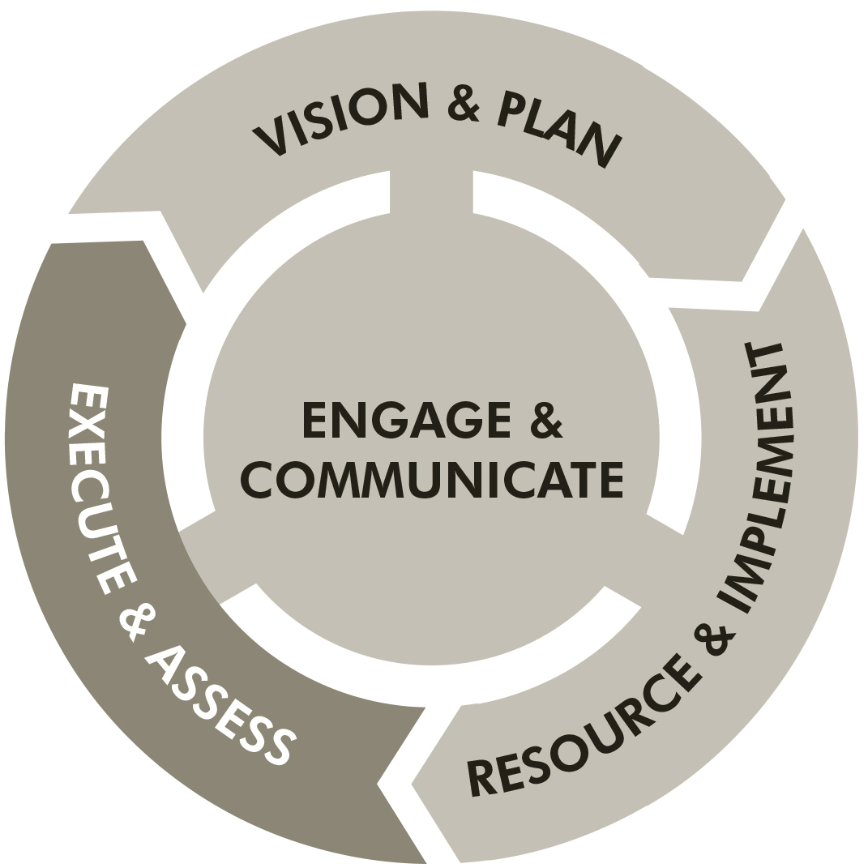
Effective Organizations Execute & Assess
Vital organizations
execute their plans
to the best of their
corporate ability,
assessing and
encouraging
performance as they go.

Slide 23
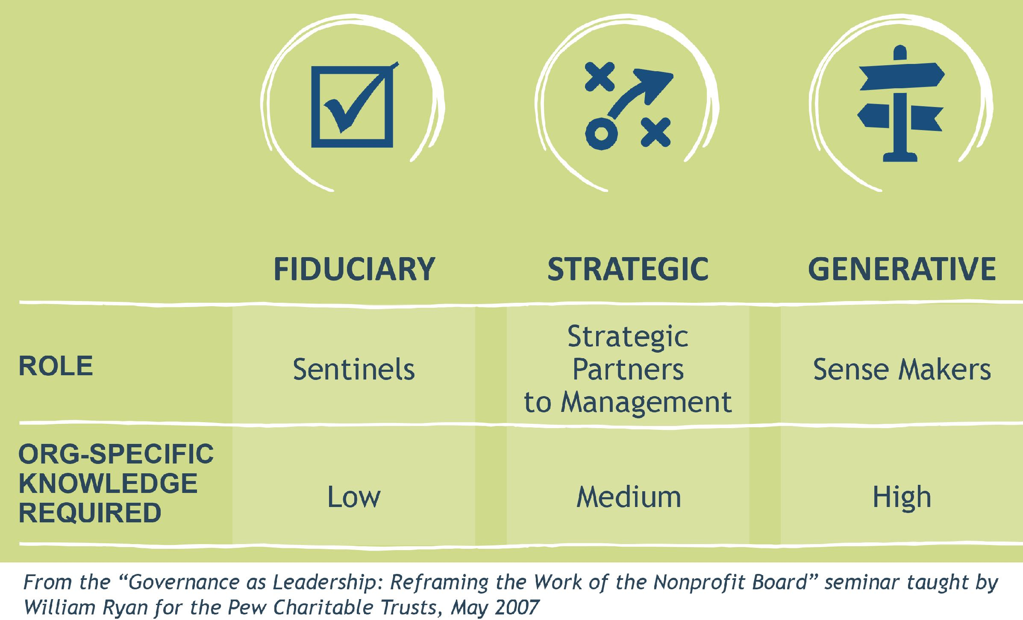
Understanding the Board’s Role

Slide 24
Strategic Thinking—The Board and CEO’s Roles
    “There is nothing more important for a CEO than having the right strategy and right choice of goals, and for the board, the right strategy is second only to having the right CEO.” Ram Charan

Slide 25
VIRTUAL BREAKOUT
Do you have a culture of planning and execution?
Do you have an established planning process?
Do the Board Chair and CEO/ED work together to manage and monitor planning?
Does the Board evaluate its CEO/ED based upon the organization’s performance in relationship to its plans?

Slide 26
ZOOM QUIZ
Types of Plans

Slide 27
Scenario Planning: Resources
Peter Schwartz, The Art of the Long View
Thomas Chermack, Scenario Planning in Organizations
Diana Scearce, Katherine Fulton & Global Business Network, What If? The Art of Scenario Thinking for Nonprofits

Slide 28
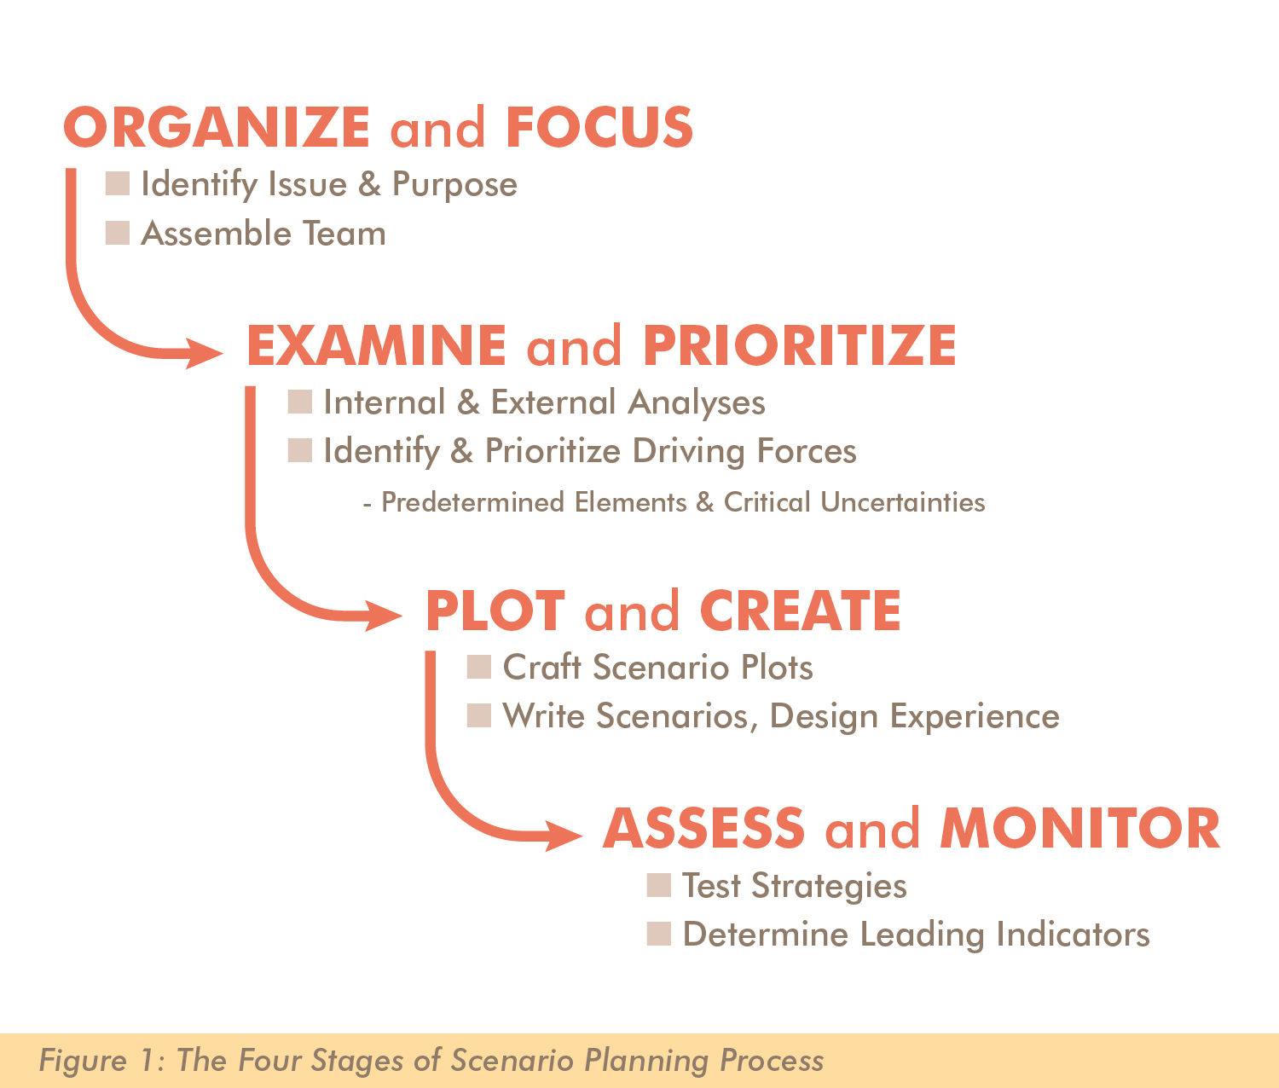

Slide 29
“There are two things a leader can influence when it comes to producing results, your ‘strategy’ and your ability to ‘execute’ your strategy.” Jim Huling

Slide 30
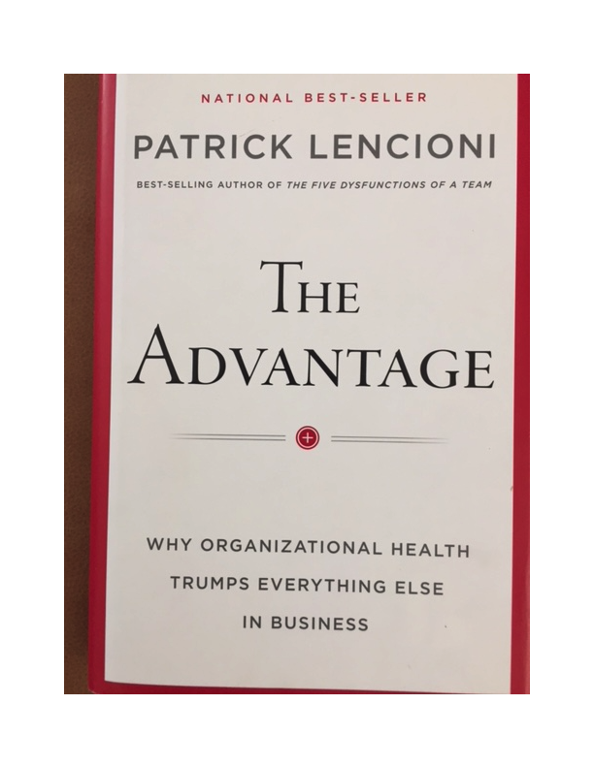
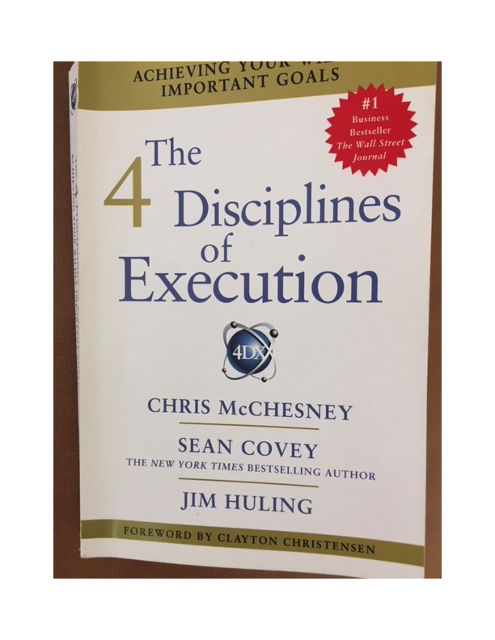

Slide 31
Six Strategic Questions
1. Why do we exist?
2. How do we behave?
3. What do we do?
4. How will we succeed?
5. What is most important, right now?
6. Who must do what?

Slide 32
The Strategy
Strategic Thinking
Strategic Planning
Creating Clarity
“Creating clarity is all about achieving alignment; alignment is about creating so much clarity that there is as little room as possible for confusion, disorder, and infighting to set in.” Lencioni

Slide 33
Question One—Why do we exist?
What Guides You?
Who Do You Serve?
NONPROFITS BEWARE—A vague mission may indicate a lack of clarity or an inability to declare who you are and what you do.

Slide 34
Question Two—How do we behave?
What Fundamental Principles Guide Your Behaviors and Decisions Reflecting the Essence of the Organization?
NONPROFITS BEWARE—You live and operate in a qualitative world. It’s harder to define and clarify the essence of who you are.

Slide 35
Question Three—What do we do?
Be clear and straight forward.
What are your essential services?
NONPROFITS BEWARE—There are so many needs, and so many people in need, it’s easy to allow your compassion to cause mission sprawl.

Slide 36
Question Four—How will we succeed?
Strategy Defined:
“An organization’s strategy is nothing more than the collection of intentional decisions a company makes to give itself the best chance to thrive and differentiate [itself].”
NONPROFITS BEWARE—You have a 1,001 aspirations, but should stick to three primary services.

Slide 37
What Are Strategic Pillars?
Name Southwest Airlines Pillars
Low Fare Airline
On-time, Short Haul, Friendly Crew
Efficient Use of Planes

Slide 38
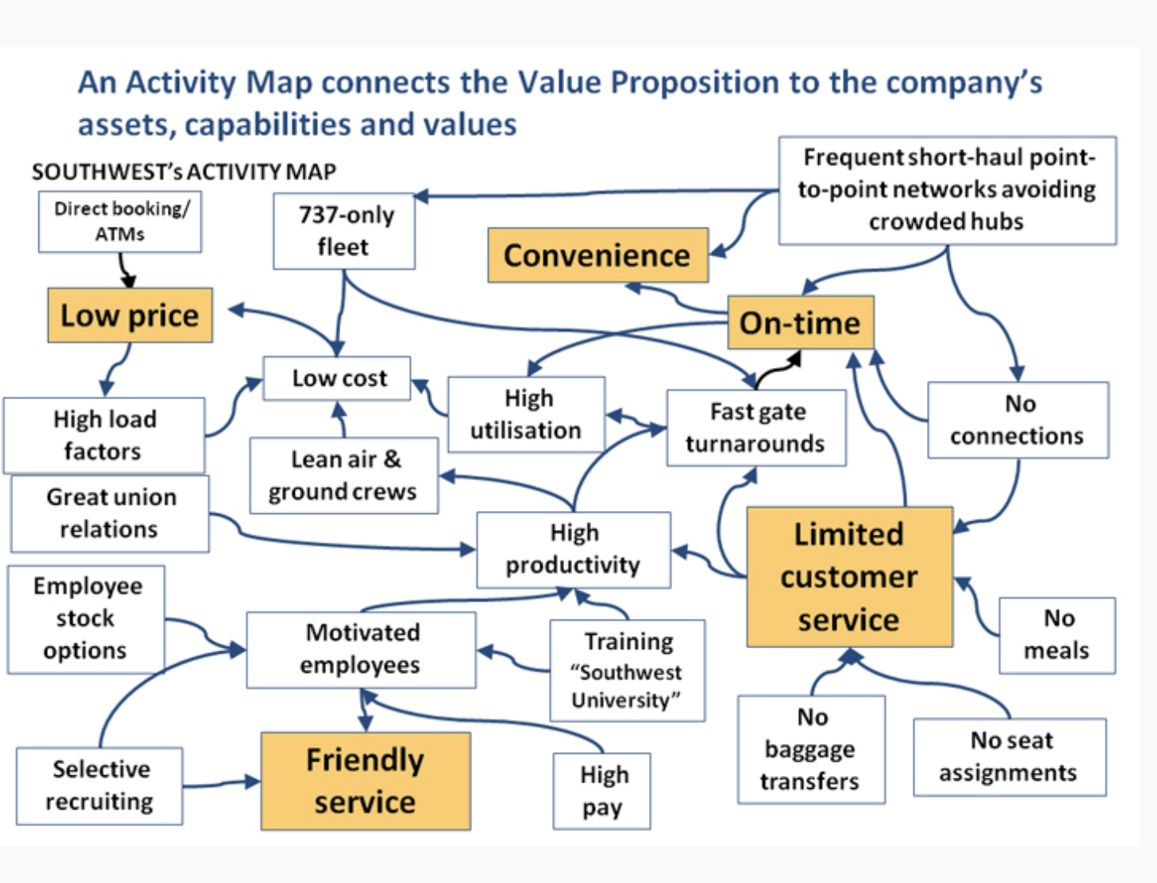

Slide 39
QUICK BREAKOUT
What Are Your Strategic Pillars?
Identify the Three Essential Things You Do
1.
2.
3.

Slide 40
Question Five—What is most important right now?
Strategic Thinking Leads to Identifying 3—5 Strategic Objectives
30 days to 1,000 days to Achieve
NONPROFITS BEWARE--There will always be more good ideas than there is capacity to execute.

Slide 41
How many goals is enough?
Number of Goals Number Achieved
11—20 0
4—10 1—2
2—3 2--3

Slide 42


Slide 43
Organizational Bandwidth for Strategic Change
Operational Activity Strategic Activity
80% 20%
85% 15%
90% 10%

Slide 44

“Deciding what not
to do is as important
as deciding what to do.”
Steve Jobs

Slide 45
Question Six—Who must do what?
“Leaders need to clearly and unambiguously stipulate what their respective responsibilities are when they go back to work to do their day jobs.” Lencioni
NONPROFITS BEWARE—Do you have vague, generic aspirations masquerading as strategic goals? Or, do you have well-articulated Strategic Objectives, linked to complementing Operational Objectives, assigned as Tactical Actions to one specific member of the Leadership Team?

Slide 46
THE INTERCONNECTIVITY
OF STRATEGIC PLANNING
The Strategic Plan
The Operational Plan
The Annual Plan
The Case Statement

Slide 47
THE DISCONNECT

Slide 48
Overcoming the Disconnect
You Have Made Plans that Will:
Expand Your Reach
Increase Your Revenue
Launch a New Program
Create New Facilities
Increase Your Effectiveness

Slide 49
The Disconnect
Lofty, Vague Goals
Too Many Goals
No Goals
Not-Ready-for Long-Range Thinking
Bound by Culture
Too Busy to Do More

Slide 50
Overcoming the Disconnect
“There are two things a leader can influence when it comes to producing results: your ‘strategy’ (or plan) and your ability to ‘execute’ that strategy.”
The solution isn’t necessarily on the Strategy side; it’s often on the Execution side.

Slide 51

Git-R-Done!
Larry the Cable Guy

Slide 52
The Execution
“I know what I need to do.
I just don’t know how to do it.”
Andy Grove—CEO Intel
The Key to effective execution is often not deciding “what” to do, the Key is learning “how” to do it.

Slide 53
The Execution
The Organizational Reality Is:
New Strategy, New Programs Mean Change!
How do you do change?
A. Send a Memo, Hold a Meeting—Announce Change?
Stroke of a Pen!
B. Foster real change through changing behavior?
Create a Culture of Planning & Execution!

Slide 54
“People weren’t sure what the goal was, weren’t committed to it, didn’t know what to do about it specifically, and weren’t being held accountable for it.”
The Four Disciplines of Execution, McChesney, Covey, Huling

Slide 55
Overcoming the Disconnect
What’s the problem with poor execution? People?
No! The problem is in the culture of execution.

Slide 56
Overcoming the Disconnect
Here’s the Secret . . . Ready?
“The real enemy of execution is your day job!”
The Tyranny of the Urgent
The Whirlwind of Operations

Slide 57
Weak Execution—Root Causes
Lack of Clarity in the Goal
Lack of Commitment to the Goal
Lack of Accountability to Achieve the Goal
Fundamental Enemy of Execution—
Day-to-Day Operations

Slide 58
QUICK -- Coach’s Breakout
Does Our Organization Have a Disconnect Between Planning & Execution?

Slide 59
Four Disciplines of Execution
Discipline 1: Focus on the wildly important
Discipline 2: Act on the lead measures
Discipline 3: Keep a compelling scorecard
Discipline 4: Create a cadence of accountability

Slide 60
Discipline 1: Focus on the wildly important
What are the two most important things you need to do?
The more you try to do, the less you will accomplish

Slide 61
Discipline 2: Act on lead measures
A lag measure tells you if you’ve achieved a goal.
A lead measure tells you if you’re likely to achieve a goal.

Slide 62
Discipline 2: Act on lead measures
Lag Measure—Metrics that Track Performance After the Fact
Lead Measure—Predictable measures influenced by team members
(X to Y by when?)

Slide 63
Discipline 2: Act on lead measures
Lag Measure—Increase annual giving by 10% ($50,000)
Lead Measure—Three Development Staff each make 2 face-to-face donor cultivation and 1-solicitation contact per week from September through December

Slide 64
Discipline 3: Keep a Compelling Scorecard
Keep Score! What you’re doing is important.
Track your activity and your immediate results.
Are you winning due to your performance?
Engage your team in achieving the goal.
Create a clear and compelling scorecard.

Slide 65
Discipline 4: Create a cadence of accountability
Where ‘execution’ comes alive.
“Unless you hold one another accountable, the ‘new’ initiative will evaporate in the whirlwind of ongoing activity and deadlines.”

Slide 66
Discipline 4: Create a cadence of accountability
Development Team 2 Cultivation 1 Solicitation
Jane 3 0
Sue 2 1
Craig 1 1
Next Week
Jane ID ID
Sue ID ID
Craig ID ID

Slide 67
Effective Strategic Planning & Execution
“Momentum comes from a clear vision of what the corporation ought to be, from a well-thought-out strategy to achieve that vision, and from carefully conceived and communicated directions and plans that enable everyone to participate and be publically accountable in achieving those plans.” Max DePree

Slide 68
If you would like a copy of the Session Slide Deck, send me your email address:
david@alexanderresourcestrategies.com
Thank you for the opportunity to serve you as you serve the common good.
David Alexander
Alexander Resource Strategies

